Slide 1
Digital Collaboration Tools

Slide 2


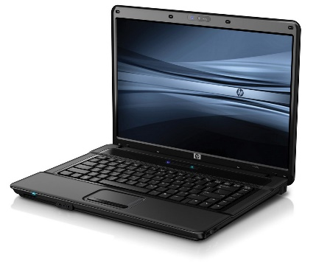
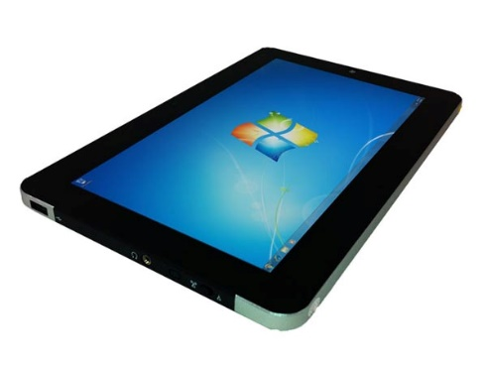
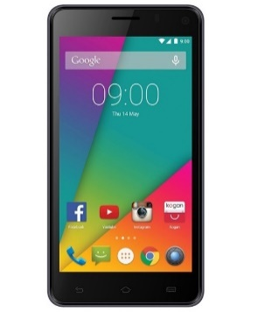





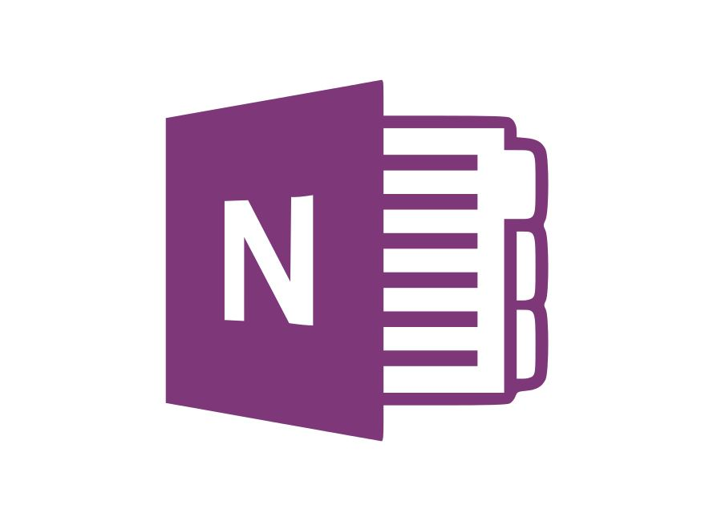
S:
For Business
Personal

Slide 3


Slide 4

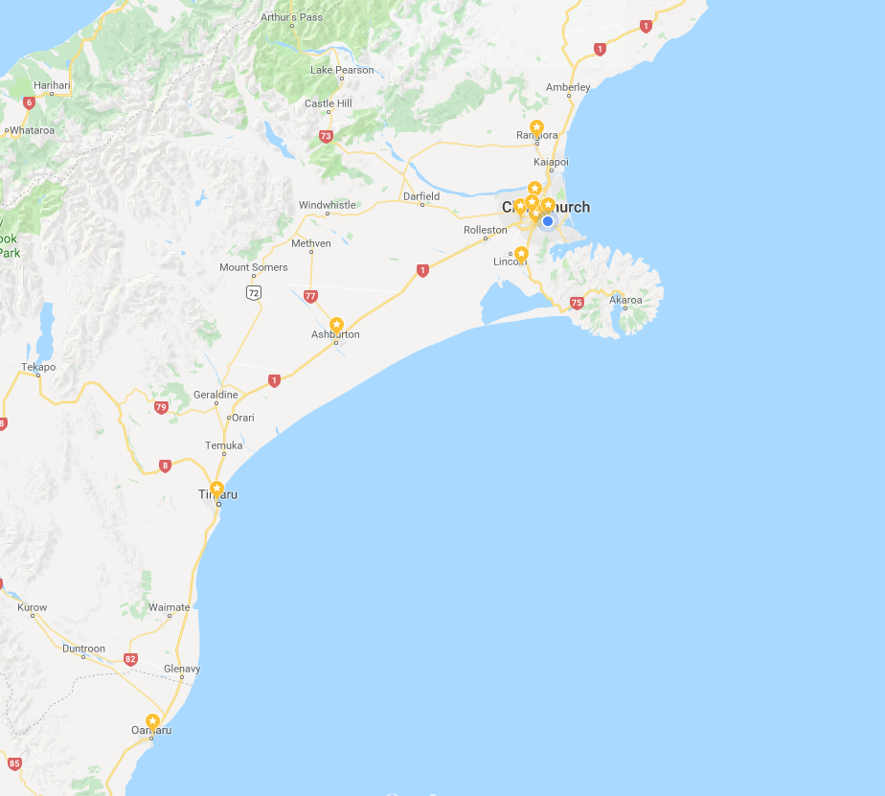
My team(s)
Rangiora
Bishopdale
City
New Brighton
Hornby
Ashburton
Timaru
Oamaru

Slide 5
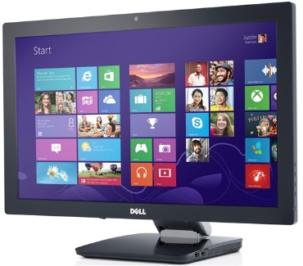





Slide 6
What I have tried
Panopto and PowerPoint for information sharing
Trello for collaboration
Coggle.it for idea generation
OneNote for single source sharing
OneDrive for sharing
Zoom for real time meetings

Slide 7
Trello
Link to Trello https://trello.com/itasatool/home
Used to:
Collect feedback on course content
Discuss/allocate to other Team Members
Checklists for jobs done
Other possible uses
Any team/collaboration groups (e.g. cross department groups)

Slide 8
Coggle.it
Just Googled “online collaboration mindmaps…”
Essentially a mind mapping software but multiple users can work on it in real time and comment on it
Great to capture thoughts and ideas before an in person meeting
https://coggle.it/diagram/WyM3aG5LgO9b3DFb/t/ace
Notes:
Use phone to add in stakeholders – MSD, local communities, businesses, Next Step Centre for Women

Slide 9
Zoom
My team has been using video conferencing tools for several years now - first Skype for Business then Zoom
Most team meetings are done through Zoom
Digital Collaboration tools support video conferencing meetings
We can share screens, all work on ONE single platform (or several) in real time – e.g. Trello, Coggle.it, OneNote

Slide 10
Requirements
Need to be always connected
Mobile tech helps – smart phone/tablet

